Slide 1
Logic, Shift & Rotate Instructions- Chapter#7

Slide 2
Introduction
Ability to manipulate bits is generally absent in high-level languages (except C).
Instructions that can be used to change the bit pattern in a byte or word.
An important reason for programming in assembly language.
Logic operations are used to change individual bits in computer.
When a logic operation is applied to operands, the result is obtained by applying the logic operation at each bit position.

Slide 3
Introduction
10101010
AND 11110000
---------------
= 10100000
10101010
OR 11110000
--------------
= 11111010
10101010
XOR 111 l0000
--------------
= 01011010

Slide 4
AND, OR , XOR instruction
AND destination, source
OR destination, source
XOR destination, source
Result of the operation is stored in the destination, which must be a register or memory location.
Source may be a constant, register, or memory location.
Memory-to-memory operations are not allowed.
SF, ZF, PF reflect the result
CF = 0, OF = 0, AF is undefined

Slide 5
Mask
One use of logic instruction is to selectively modify the bits in the destination.
Construct a source bit pattern known as mask.
The mask bits are chosen so that the corresponding destination bits are modified in the desired manner.
AND can be used to clear specific destination bits while preserving the others.
A 0-mask bit clears the corresponding destination bit.
OR can be used to set specific destination bits while preserving the others.
A 1-mask bit sits the corresponding destination bit.
XOR can be used to complement specific destination bits while preserving the others.
A 1-mask bit complements the corresponding destination bit.

Slide 6
Mask Examples
Clear the sign bit of AL while leaving the other bits unchanged
AND with 01111111b = 7Fh as the mask
AND AL,7Fh
Set the most significant and least significant bits of AL while preserving the other bits.
OR with 10000001b = 81h as the mask
OR AL,8lh
Change the sign bit of DX.
XOR with a mask of 8000h.
XOR DX,8000h

Slide 7

Mask Examples
Converting an ASCII Digit to a Number
When a program reads a character from the keyboard
AL gets the ASCII code of the character.
To get number in AL, SUB AL, 30h
Another method is to use the AND instruction to clear the high nibble (high four bits) of AL. AND AL,0Fh
Converting a Lowercase Letter to Upper Case
ASCII codes of "a" to "z" range from 61h to 7Ah and "A" to "Z" go from 41h to 5Ah
AND with the mask 11011111b, or 0DFh
AND DL,0DFh

Slide 8
NOT Instruction
The NOT instruction performs the one's complement operation on the destination. The format is
NOT destination
There is no effect on the status flags.
Complement the bits in AX which contains 0094h.
MOV AX,0094 // 0000000010010100
NOT AX // 1111111101101011 or FF6B

Slide 9
TEST Instruction
TEST Instruction performs an AND operation of the destination with the source but does not change the destination contents.
Purpose of the TEST instruction is to set the status flags. The format is
TEST destination, source
Effect on flags
SF, ZF, PF reflect the result
CF = 0, OF = 0, AF is undefined

Slide 10
SHL & SHR instruction
SHL (shift left) performs left shifts on the destination Where CL single left shifts are made
SHL destination, 1
SHL destination, CL
0 is inserted into the rightmost bit position and the msb is shifted into CF
SHR (shift right) performs right shifts on the operand.
SHR destination,1
SHR destination, CL
0 is inserted into the msb position, and the rightmost bit is shifted into CF.
Effect on flags
SF, PF, ZF reflect the result
AF is undefined
CF= last bit shifted out
OF= 1 if result changes sign on last shift

Slide 11
SHR & SHL Example
DH contains 8Ah and CL contains 3. What are the values of DH and of CF After the instruction SHL DH,CL is executed ?
MOV DH, 8Ah //10001010
MOV CL, 3
SHL DH, CL //01010000 = 50h & CF=0
DH contains 8Ah and CL contains 2. What are the values of DH and CF after the instruction SHR DH,CL is executed?
MOV DH, 8Ah //10001010
MOV CL, 2
SHR DH, CL //00100010b = 22h & CF=1
Suppose AL contains 11001011b and CL contains 1. What are the values of AL and CF after execution of following instructions?
SHR AL, CL SHL AL, CL

Slide 12
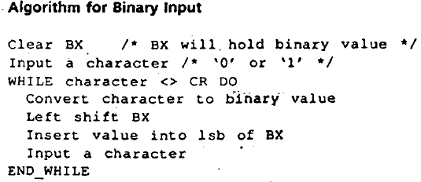
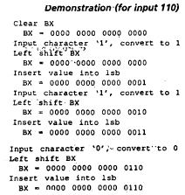
Binary Input Application

Slide 13
Binary Input Application
XOR BX,BX : clear BX
MOV AH,1 : input char function
INT 21h : Read a character
while:
CMP AL,0Dh ;CR?
JE endwhile ;yes, done
AND AL,0Fh ;no, convert to binary
SHL BX,1 ;make room for new value
OR BL,AL ;put value into BX
INT 21h ;read a character
JMP while ;loop back
endwhile:

Slide 14
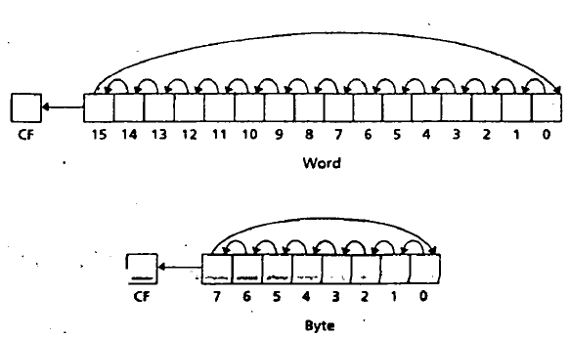
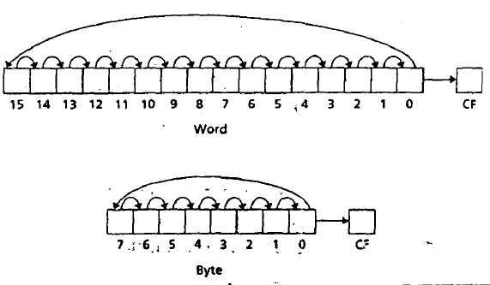
ROL & ROR Instruction
ROL (rotate left) shifts bits to the left. msb is shifted into the rightmost bit. Also, into the CF.
ROL destination, 1
ROL destination, CL
ROR (rotate right) shift bits to the right. Rightmost bit is shifted into the msb. Also, into the CF.
ROR destination, 1
ROR destination, CL

Slide 15
Examples
What are the values of DH and CF after instruction execution.
MOV DH, 8Ah //10001010
MOV CL, 2
ROL DH, CL //00101010 = 2Ah & CF=0
MOV DH, 8Ah //10001010
MOV CL, 2
ROR DH,CL //10100010 = A2h & CF=1
AL contains 11001011b and CL contains 2. What are the values of AL and CF after execution of following instructions?
ROR AL, CL ROL AL, CL

Slide 16
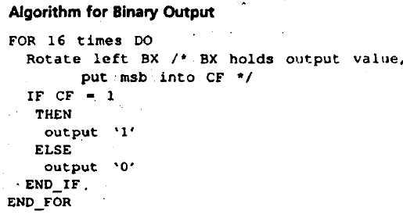
Binary Output Application

Slide 17
Binary Output Application
MOV CX, 16
MOV AH, 2
Repeat:
ROL BX, 1
JNC else
if:
MOV DL, 1
INT 21h
JMP end
else:
MOV DL, 0
INT 21h
end:
Loop Repeat

Slide 18
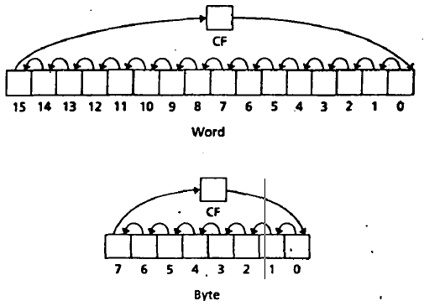
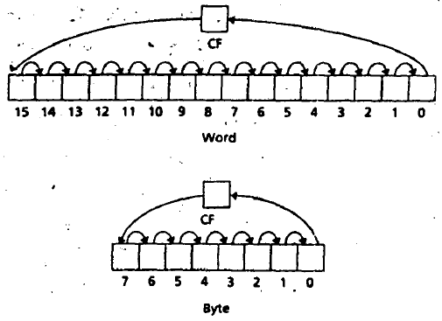
Rotate Carry Left Instruction
RCL (Rotate through Carry Left) shifts the bits of the destination to the left.
msb is shifted into the CF, and the previous value of CF is shifted into the right most bit.
RCL destination, 1
RCL destination, CL
RCR (Rotate through Carry Right) works just like RCL, except that the bits are rotated to the right.
RCR destination, 1
RCR destination, CL

Slide 19
Examples
Suppose DH contains 8Ah and CF=1, CL contains 3. What are the values of DH and CF after the instruction
RCL DH,CL & RCR DH,CL are executed?
MOV DH, 8Ah //10001010
MOV CL, 3
RCL DH,CL //01010110 = 56h
CF=0
MOV DH, 8Ah //10001010
MOV CL, 3
RCR DH,CL //10110001 = B1h
CF=0

Slide 20
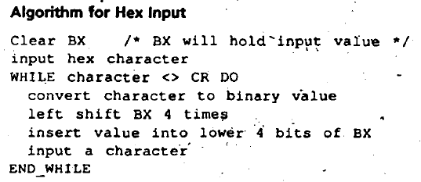
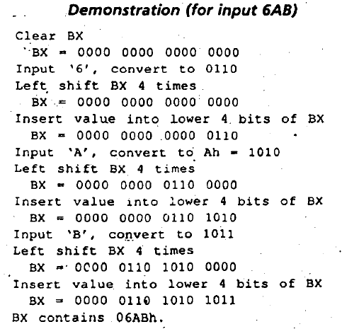
Hex Input / Output Application

Slide 21
Hex Input Application
XOR BX,BX
MOV CL,4
MOV AH,1
INT 21H
WHILE:
CMP AL,0DH
JE END_WHILE
CMP AL,39H
JG LETTER
AND AL,0FH
JMP SHIFT
LETTER:
SUB AL,37H
Shift:
SHL BX,CL
OR BL,AL
INT 21H
JMP WHILE
END_WHILE:

Slide 22
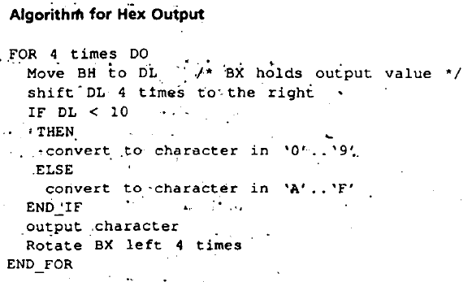
Hex Output Application

Slide 23

Exercise
G1ve logic instruction to do each of the following.
a. Clear the even-numbered bits of AX, leaving the
other bits unchanged.
b. Set the most and least significant bits of BL, leaving the other bits unchanged.
c. Complement the msb of DX, leaving the other bits unchanged
Write a program that prompts the user to enter a character, and on subsequent lines prints its ASCII code in binary, and the number of 1 bits in its ASCII code.

Slide 24



Exercise
Write a program that prompts the user to enter a character and prints the ASCII code of the character in hex on the next line. Repeat this process until the user types a carriage return.
Write a program that prompts the user to type a hex number of four hex digits or less, and outputs it in binary on the next line. If the user enters an illegal character, he or she should be prompted to begin again. Accept only uppercase letters.
Write a program that prompts the user to type a binary number of 16 digits or less, and outputs It In hex on the next line. If the user enters an illegal character, he or she should be prompted to begin again.

Slide 25
Exercise
Suppose AL contains 11001011b and CF= l. Give the new contents of AL after each of the following instructions is executed.
SHL AL, 1
SHR AL, 1
ROL AL, CL if CL contains 2
ROR AL, CL if CL contains 3
RCL AL, 1
RCR AL, CL if CL contains 3

Slide 26
